Slide 1
Introduction to AI
‹#›

Slide 2
What is AI?
an attempt of
AI is the reproduction of human reasoning and intelligent behavior by computational methods
Intelligent
behavior
Computer
Humans
‹#›

Slide 3
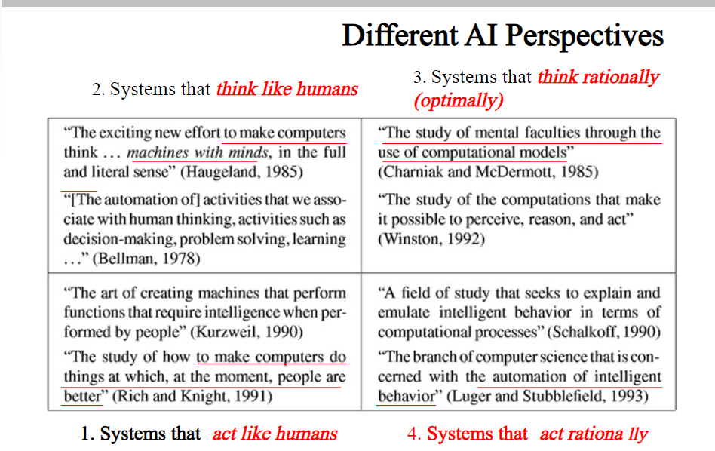

Slide 4
What is AI? (R&N)
Discipline that systematizes and automates reasoning processes to create machines that:
Act like humans | Act rationally
Think like humans | Think rationally
A human Centered approach must be an empirical Science,
involving Hypothesis and Experimental Confirmation.
A rationalist approach involves a combination of mathematics and
engineering.
A system is rational if it does the ”right thing” given what it knows.
‹#›

Slide 5
Act like humans | Act rationally
Think like humans | Think rationally
The goal of AI is to create computer systems that perform tasks regarded as requiring intelligence when done by humans
🡪 AI Methodology: Take a task at which people are better, e.g.:
Prove a theorem
Play chess
Plan a surgical operation
Diagnose a disease
Navigate in a building
and build a computer system that does it automatically
But do we want to duplicate human imperfections?
‹#›

Slide 6
Why AI
Solve real world problems very easily and accurately such as health issue , marketing, traffic issue etc.
Create personal virtual assistant like siri, google assistance.
Robot which can work in a environment where survival of human can be at risk
‹#›

Slide 7
Goals of AI
Replicate Human Intelligence
Solve Knowledge –intensive task
An intelligent connection of perception and action
Building a m/c which can perform task that requires human intelligence such as:
Providing theorem
Playing chess
Plan surgical operation
Driving a car
‹#›

Slide 8
Intelligence Composed of
Linguistic Intelligence
Reasoning
Intelligence
Problem Solving
Learning
Perception
‹#›

Slide 9
Can Machines Act/Think Intelligently?
“If there were machines which bore a resemblance to our bodies and imitated our actions as closely as possible for all practical purposes, we should still have two very certain means of recognizing that they were not real men. The first is that they could never use words, or put together signs, as we do in order to declare our thoughts to others… Secondly, even though some machines might do some things as well as we do them, or perhaps even better, they would inevitably fail in others, which would reveal that they are acting not from understanding, …”
Discourse on the Method, by Descartes (1598-1650)
‹#›

Slide 10
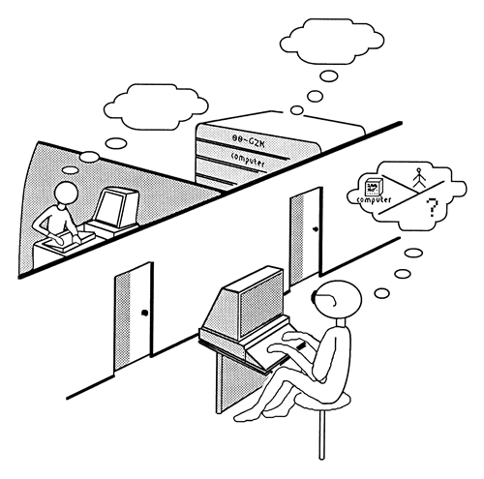
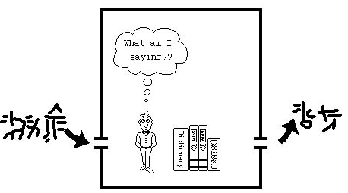
Can Machines Act/Think Intelligently?
Turing Test: Acting humanly
http://plato.stanford.edu/entries/turing-test/
Test proposed by Alan Turing in 1950 was designed to provide a satisfactory operational definition of intelligence.
The computer is asked questions by a human interrogator. It passes the test if the interrogator cannot tell whether the responses come from a person or not
No physical interaction
Chinese Room (J. Searle)
‹#›

Slide 11
The computer would need to possess the following capabilities:
natural language processing to enable it to communicate successfully in English (or some other human language);
knowledge representation to store information provided before or during the interrogation;
automated reasoning to use the stored information to answer questions and to draw new conclusions;
machine learning to adapt to new circumstances and to detect and extrapolate patterns.
computer vision to perceive objects, and
robotics to move them about
‹#›

Slide 12
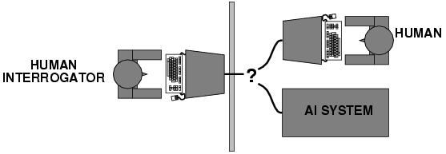
Thinking Humanly: The cognitive approach
"Can machines think?" 🡪 "Can machines behave intelligently
The interdisciplinary field of cognitive science brings together computer models from AI and experimental techniques from psychology to try to construct precise and testable theories of the workings of the human mind.
There are two ways to do this:
Introspection—trying to catch our own thoughts as they go by
psychological experiments.
GPS : general problem solver
‹#›

Slide 13
Thinking Rationally Codify ”Right Thinking”
logic
The development of formal which , provided a precise notation for statements about all kinds of things in the world and the relations between them.
There are two main obstacles to this approach.
It is not easy to take informal knowledge and state it in the formal terms required by logical notation.
There is a big difference between being able to solve a problem "in principle" and doing so in practice.
‹#›

Slide 14
Acting Rationally
rational agent
Acting rationally means acting so as to achieve one's goals, given one's beliefs. An agent is just something that perceives and acts.
It act to achieve best outcome or when there is a uncertainty the best expected outcome.
low of thought : correct inferences
‹#›

Slide 15
Academic Disciplines relevant to AI
Philosophy Logic, methods of reasoning, mind as physical system, foundations of learning, language, rationality.
Mathematics Formal representation and proof, algorithms, computation, (un)decidability, (in)tractability
Probability/Statistics modeling uncertainty, learning from data
Economics utility, decision theory, rational economic agents
Neuroscience neurons as information processing units.
Psychology/ how do people behave, perceive, process cognitive
Cognitive Science information, represent knowledge.
Computer building fast computers engineering
Control theory design systems that maximize an objective function over time
Linguistics knowledge representation, grammars
‹#›

Slide 16
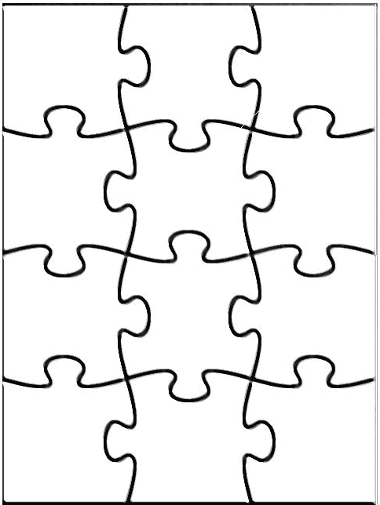
Main Areas of AI
Knowledge representation (including formal logic)
Search, especially heuristic search (puzzles, games)
Planning
Reasoning under uncertainty, including probabilistic reasoning
Learning
Agent architectures
Robotics and perception
Natural language processing
Agent
Perception
Robotics
Reasoning
Search
Learning
Knowledge rep.
Constraint satisfaction
Planning
Natural language
...
Expert
Systems
‹#›

Slide 17
History of AI
1943: early beginnings
McCulloch & Pitts: Boolean circuit model of brain
1950: Turing
Turing's "Computing Machinery and Intelligence“ ,therein introduced tuning test , machine learning , genetic and reinforcement learning algo
1956: birth of AI
McCarthy : Dartmouth college meeting: "Artificial Intelligence“ name adopted
1950s: initial promise
Early AI programs, including
Samuel's checkers program
Newell & Simon's Logic Theorist
1955-65: “great enthusiasm”
Newell and Simon: GPS, general problem solver
Gelertner: Geometry Theorem Prover
McCarthy: invention of LISP

Slide 18
History of AI
1966—73: Reality dawns
Realization that many AI problems are intractable
Limitations of existing neural network methods identified
Neural network research almost disappears
1969—85: Adding domain knowledge
Development of knowledge-based systems
Success of rule-based expert systems,
E.g., DENDRAL, MYCIN
But were brittle and did not scale well in practice
1986-- Rise of machine learning
Neural networks return to popularity
Major advances in machine learning algorithms and applications
1990-- Role of uncertainty
Bayesian networks as a knowledge representation framework
1995-- AI as Science
Integration of learning, reasoning, knowledge representation
AI methods used in vision, language, data mining, etc

Slide 19
The State of The Art
Game Playing: Deep Blue defeated the reigning world chess champion Garry Kasparov in 1997
Autonomous Planning and Scheduling: NASA's on-board autonomous planning program controlled the scheduling of operations for a spacecraft
Autonomous Control:ALVINN computer vision was trained to steer a car to keep in lane. No hands across America (driving autonomously 98% of the time from Pittsburgh to San Diego)
Logistics Planning: During the 1991 Gulf War, US forces deployed an AI logistics planning and scheduling program (DART) that involved up to 50,000 vehicles, cargo, and people
Language Understanding and Problem Solving: Proverb solves crossword puzzles better than most humans
Diaganosis:Medical diagnosis based on probabilistic analysis have been able to perform at level of an expert in areas of medicine
‹#›

Slide 20
Consider what might be involved in building a “intelligent” computer….
What are the “components” that might be useful?
Fast hardware?
Foolproof software?
Chess-playing at grandmaster level?
Speech interaction?
speech synthesis
speech recognition
speech understanding
Image recognition and understanding ?
Learning?
Planning and decision-making?
‹#›

Slide 21
Can we build hardware as complex as the brain?
How complicated is our brain?
a neuron, or nerve cell, is the basic information processing unit
estimated to be on the order of 10 ¹¹ neurons in a human brain
many more synapses (10 ¹⁴) connecting these neurons
cycle time: 10 ⁻³ seconds (1 millisecond)
How complex can we make computers?
10⁶ or more transistors per CPU
supercomputer: hundreds of CPUs, 10 ⁹ bits of RAM
cycle times: order of 10 ⁻ ⁸ seconds
Conclusion
YES: in the near future we can have computers with as many basic processing elements as our brain, but with
far fewer interconnections (wires or synapses) than the brain
much faster updates than the brain
but building hardware is very different from making a computer behave like a brain!
‹#›

Slide 22
Must an Intelligent System be Foolproof?
A “foolproof” system is one that never makes an error:
Types of possible computer errors
hardware errors, e.g., memory errors
software errors, e.g., coding bugs
“human-like” errors
Clearly, hardware and software errors are possible in practice
what about “human-like” errors?
An intelligent system can make errors and still be intelligent
humans are not right all of the time
we learn and adapt from making mistakes
e.g., consider learning to surf or ski
we improve by taking risks and falling
an intelligent system can learn in the same way
Conclusion:
NO: intelligent systems will not (and need not) be foolproof
‹#›

Slide 23
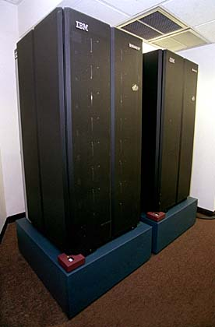
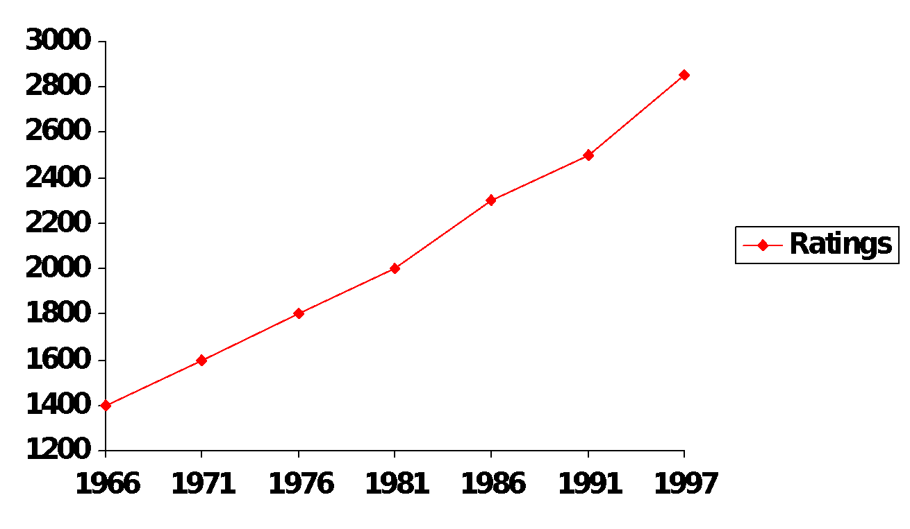
Can Computers play Humans at Chess?
Chess Playing is a classic AI problem
well-defined problem
very complex: difficult for humans to play well
Deep Blue
Garry Kasparov (current World Champion)
Conclusion: YES: today’s computers can beat even the best human
‹#›

Slide 24
Can Computers “see”?
Recognition v. Understanding (like Speech)
Recognition and Understanding of Objects in a scene
look around this room
you can effortlessly recognize objects
human brain can map 2d visual image to 3d “map”
Why is visual recognition a hard problem? Conclusion: mostly NO: computers can only “see” certain types of objects under limited circumstances: but YES for certain constrained problems (e.g., face recognition)
‹#›

Slide 25
Can Computers Recognize Speech?
Speech Recognition:
mapping sounds from a microphone into a list of words.
Hard problem: noise, more than one person talking,
occlusion, speech variability,..
Even if we recognize each word, we may not understand its meaning.
Recognizing single words from a small vocabulary
systems can do this with high accuracy (order of 99%)
e.g., directory inquiries
limited vocabulary (area codes, city names)
computer tries to recognize you first, if unsuccessful hands you over to a human operator
saves millions of dollars a year for the phone companies
‹#›

Slide 26
Recognizing human speech (ctd.)
Recognizing normal speech is much more difficult
speech is continuous: where are the boundaries between words?
e.g., “John’s car has a flat tire”
large vocabularies
can be many tens of thousands of possible words
we can use context to help figure out what someone said
try telling a waiter in a restaurant: “I would like some dream and sugar in my coffee”
background noise, other speakers, accents, colds, etc
on normal speech, modern systems are only about 60% accurate
Conclusion: NO, normal speech is too complex to accurately recognize, but YES for restricted problems
(e.g., recent software for PC use by IBM, Dragon systems)
‹#›

Slide 27
Can Computers Understand speech?
Understanding is different to recognition:
“Time flies like an arrow”
assume the computer can recognize all the words
but how could it understand it?
1. time passes quickly like an arrow?
2. command: time the flies the way an arrow times the flies
3. command: only time those flies which are like an arrow
4. “time-flies” are fond of arrows
only 1. makes any sense, but how could a computer figure this out?
clearly humans use a lot of implicit commonsense knowledge in communication
Conclusion: NO, much of what we say is beyond the capabilities of a computer to understand at present
‹#›

